Slide 1
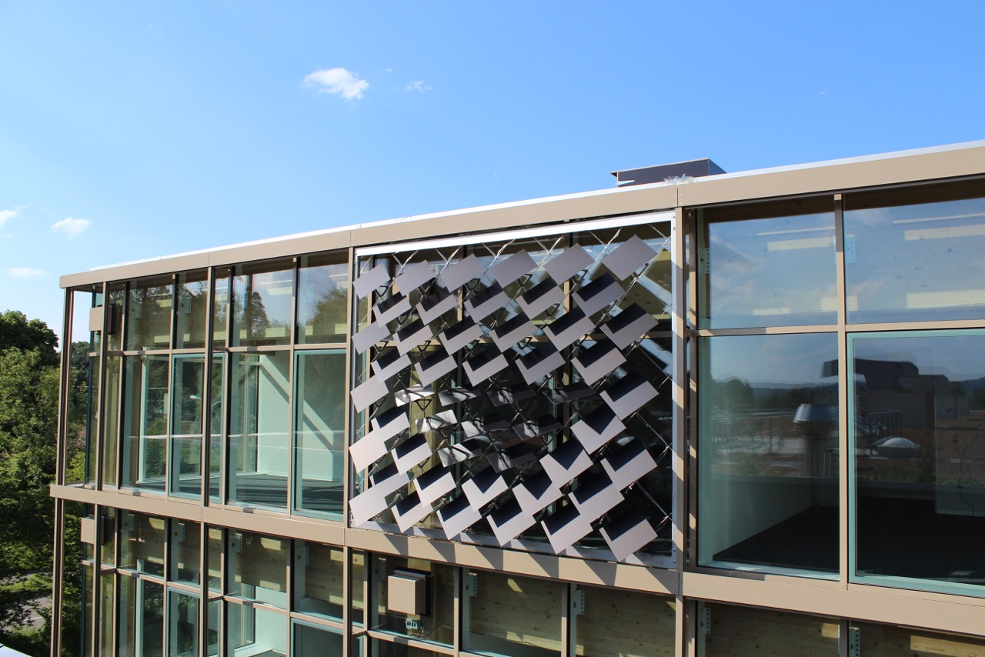
Numerical Energy Analysis of PV Modules as Adaptive Building Shading Systems
Master Thesis
Jeremias Schmidli
Supervisor:
Prageeth Jayathissa

Slide 2
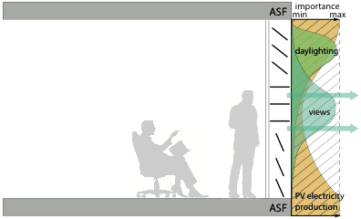
The Adaptive Solar Façade (ASF)
Individually Actuated Panels
Combines Dynamic Shading with PV-Electricity Production
Needs to Be Optimized for Cooling, Heating, Lighting and PV-Electricity Production

Slide 3
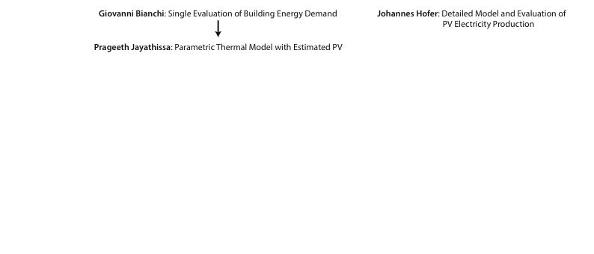


Previous Work

Slide 4
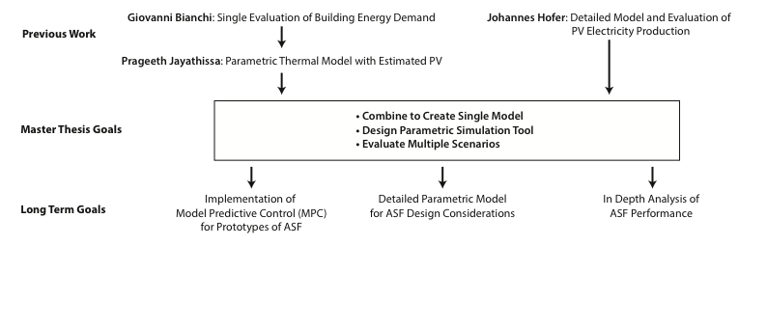
Goal of the Thesis
Notes:
Evaluate multiple scenarios of the asf,
for example building oriention, location or building system sensitivity

Slide 5
Overview
Introduction
Problem Description
Methodology
Results and Discussion
Conclusions and Outlook

Slide 6
Problem Description
Optimization Problem
Minimize: C + H + L – PV
C = Cooling Electricity Demand
H = Heating Electricity Demand
L = Lighting Electricity Demand
PV = Photovoltaic Electricity Supply

Slide 7
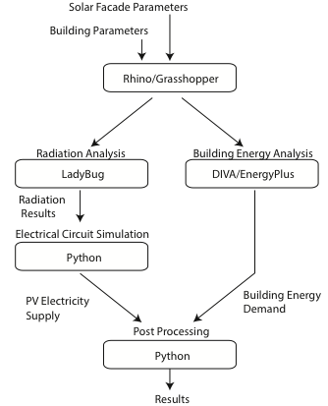
Methodology
Combination Of Different Tools To Achieve Optimal Results
Minimize: C + H + L – PV
Notes:
Top to bottom

Slide 8
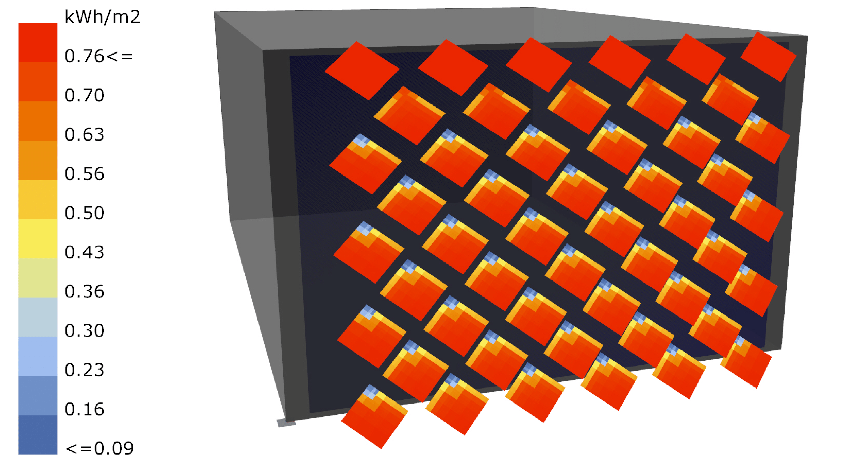
Radiation and PV analysis
(Collaboration with Johannes)
Radiation Analysis with Ladybug
Includes Self-Shading
Detailed PV Simulation with Python
Electrical Model includes Temperature and Radiation Dependency
Insolation from 12:00-13:00 on August 11

Slide 9
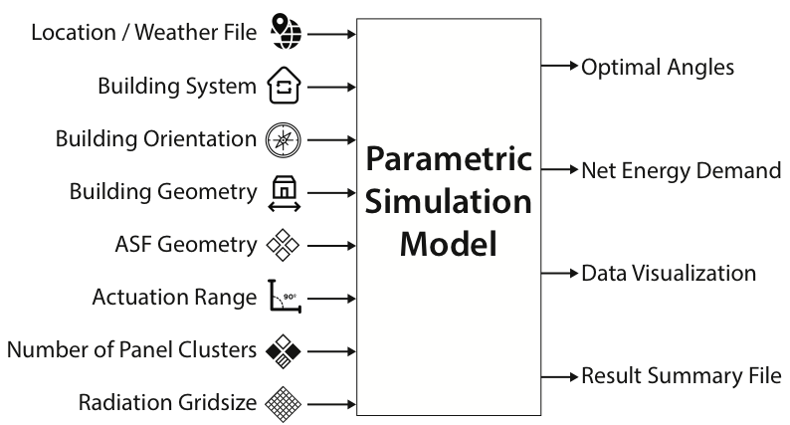
Parametric Model
Notes:
Developed tool that can be used by everyone
Downloadable at Github
Clusters of independently actuated panels
Detailed description of output

Slide 10
Base Case
Single Zone Office
Simulation for One Year
Weather File for Kloten-Zurich
Heating COP: 4
Cooling COP: 3
Lighting Load: 11.74 W/m²
Infiltration Rate: 1/h
50 Panels in a Single Cluster
Notes:
Dont read the parameters

Slide 11
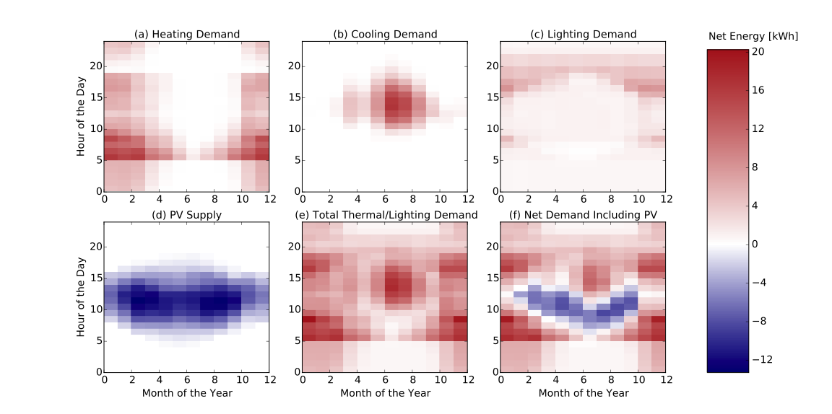
Net Energy Demand at Optimum Panel Angles

Slide 12
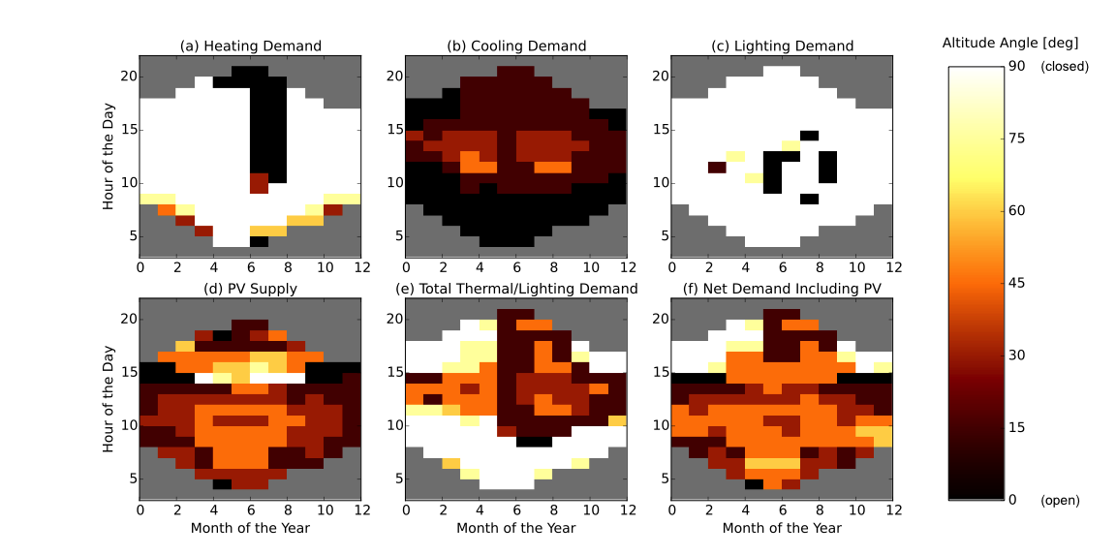
Optimum Altitude Angles of Panels

Slide 13
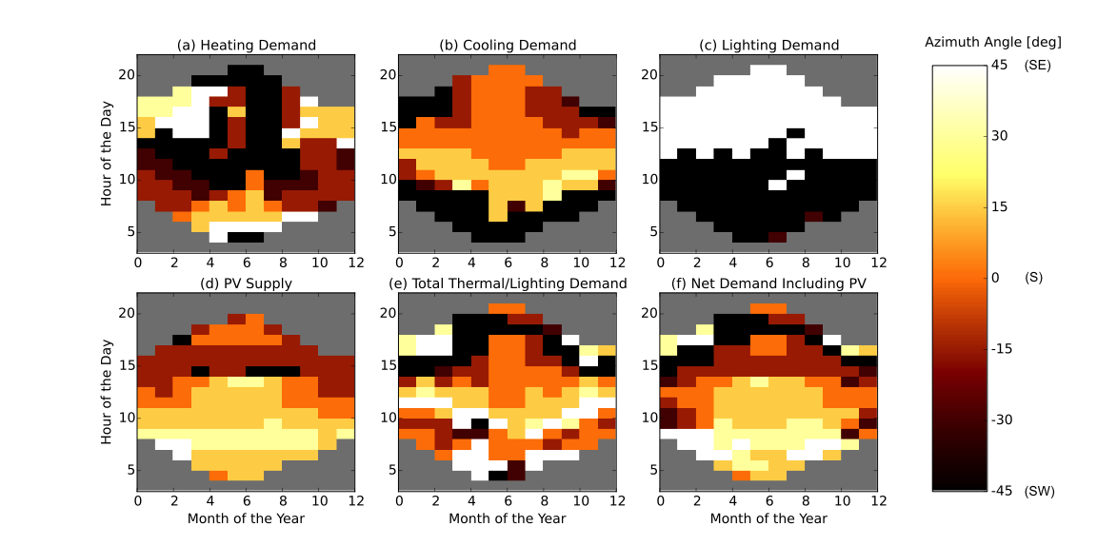
Optimum Azimuth Angles of Panels

Slide 14
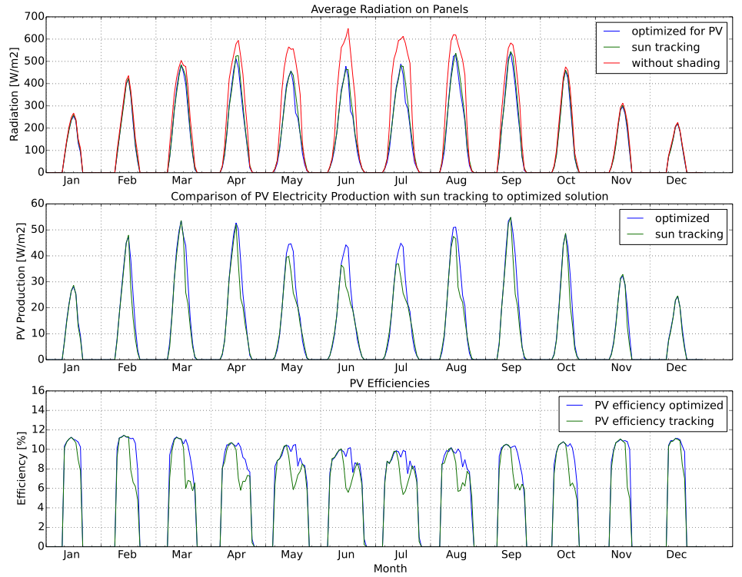
PV: Sun-Tracking vs. Optimization
- Similar Radiation
- Large Loss due to Shading

Slide 15
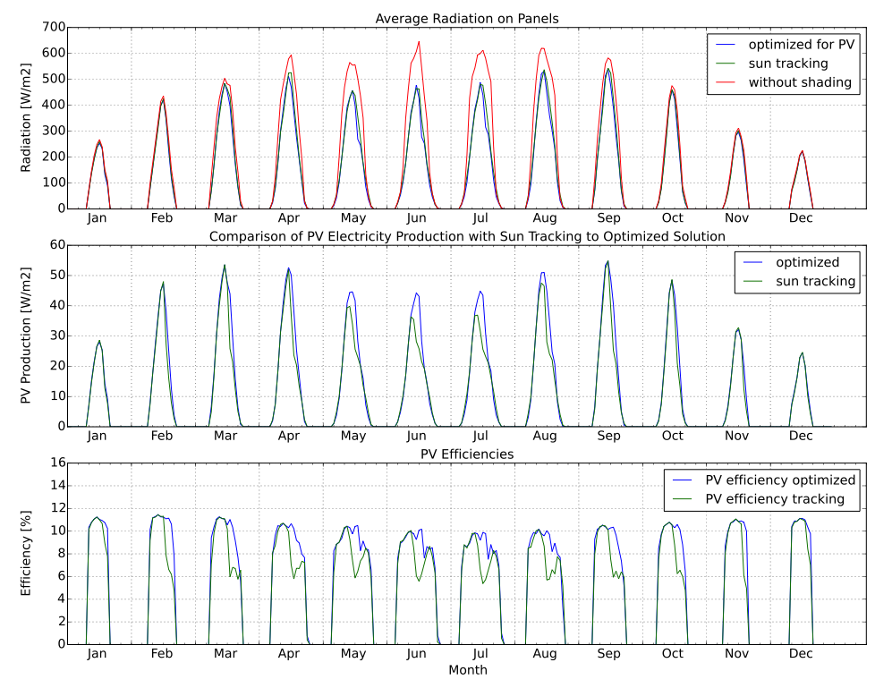
PV: Sun-Tracking vs. Optimization
- Similar Radiation
- Large Loss due to Shading
- Higher Electricity Production for Optimized Solution
- Higher Efficiency with Optimized Solution
Notes:
Give a small conclusion

Slide 16
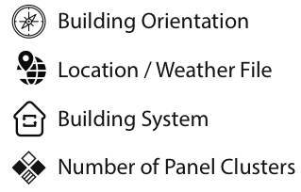
Parameter Variations
Performance Evaluation in Dependence of:

Slide 17
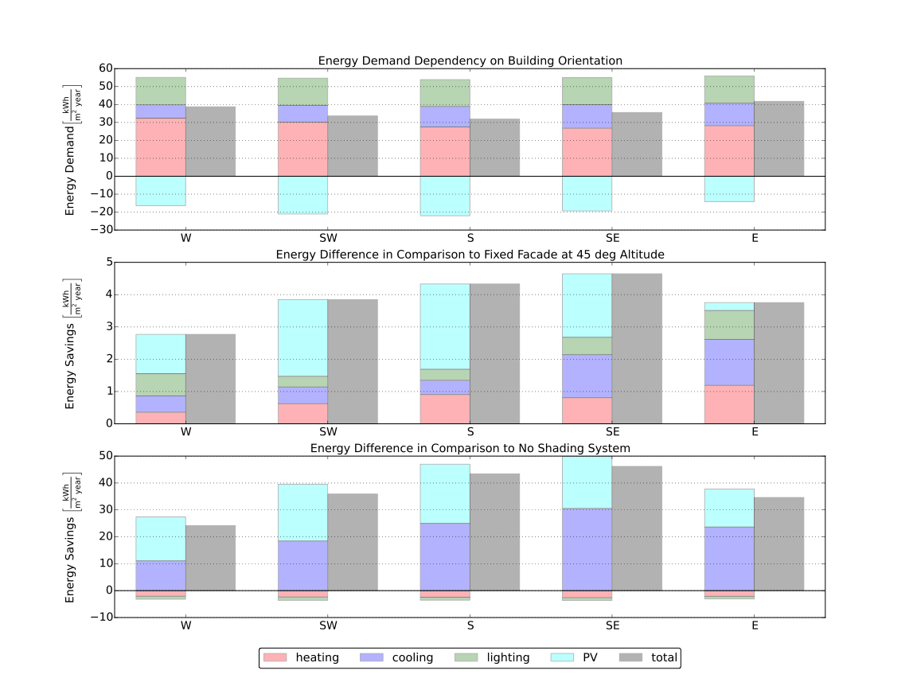
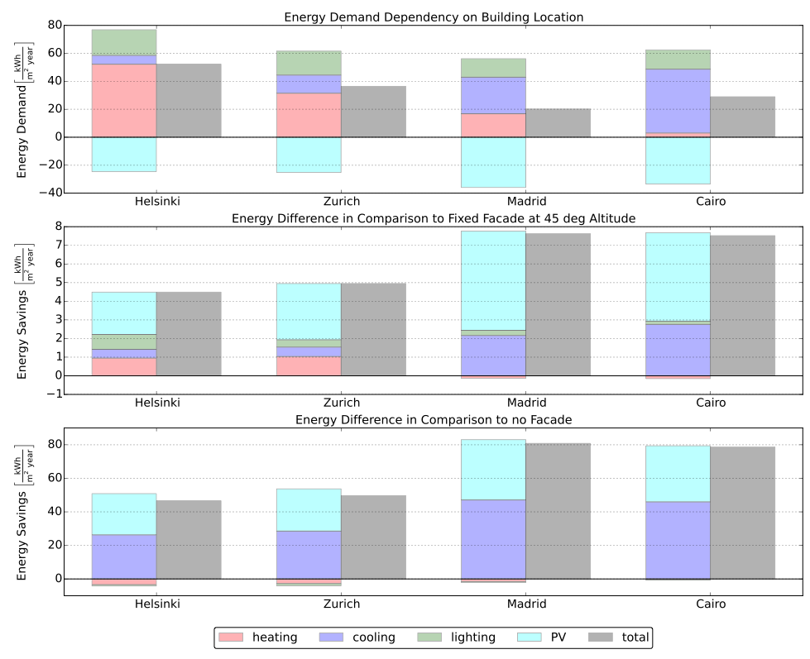
Building Orientation Performance
South facing office performs best
Notes:
Energy Difference in Comparison to no shading system (change figure)

Slide 18
Building Orientation Performance
South facing office performs best
Highest benefit from ASF for south-east facing facade due to cooling
Notes:
Energy Difference in Comparison to no shading system (change figure)

Slide 19
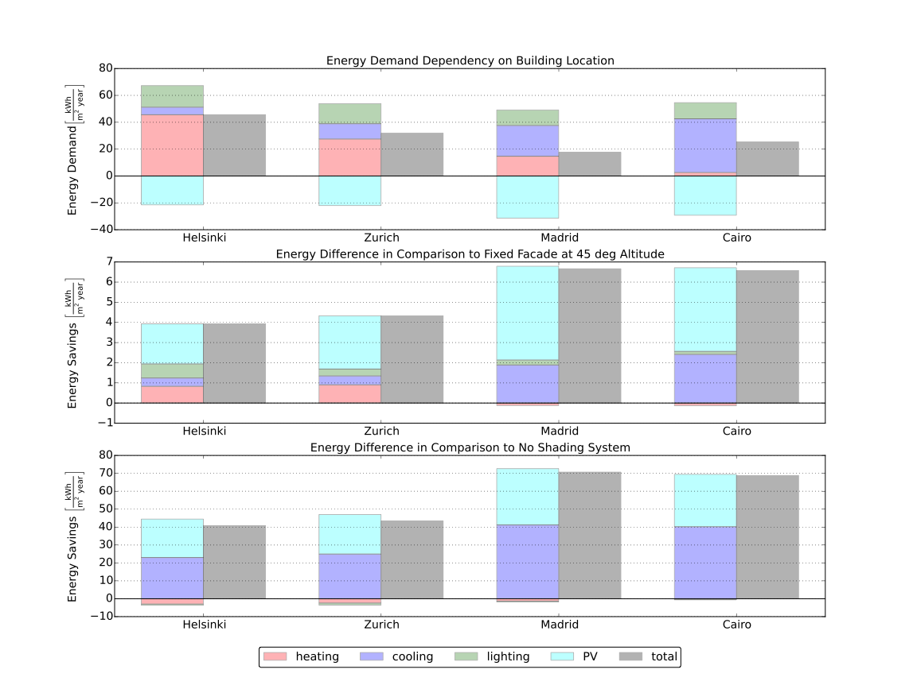
Building Location Performance
Office in Madrid performs best

Slide 20
Building Location Performance
Office in Madrid performs best
Highest benefit from ASF for warm
regions

Slide 21
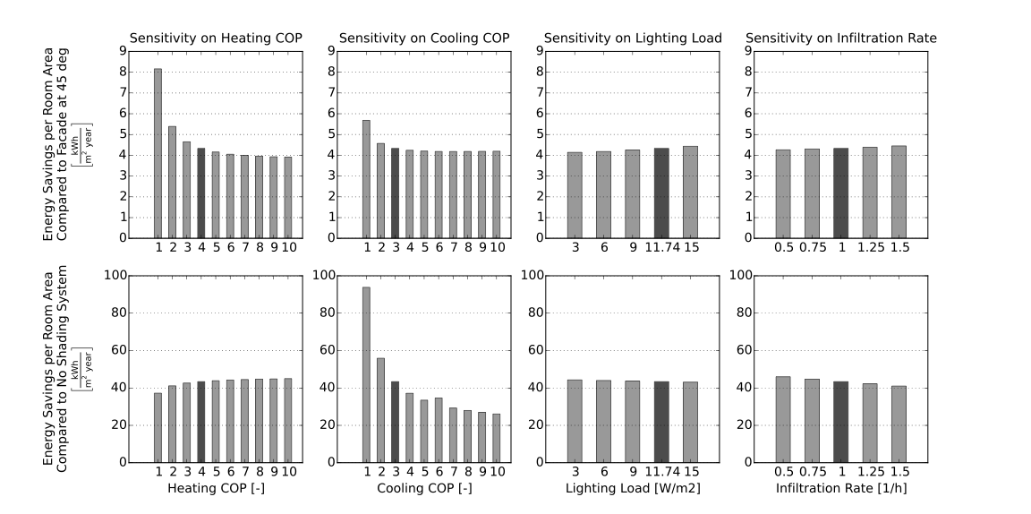
Building System Sensitivity
High sensitivity on heating COP and cooling COP
Lower sensitivity on lighting load and infiltration rate
Notes:
Give Conclusion

Slide 22
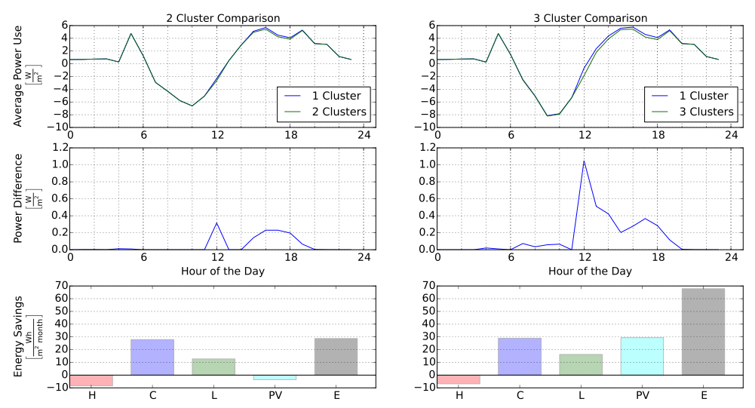


Cluster Analysis
2 Clusters
3 Clusters
June
1%
2.3%
Average of
Mar, Jun,
Sep, Dec

Slide 23
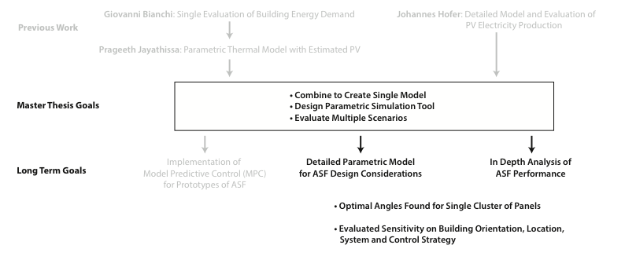
Conclusions

Slide 24
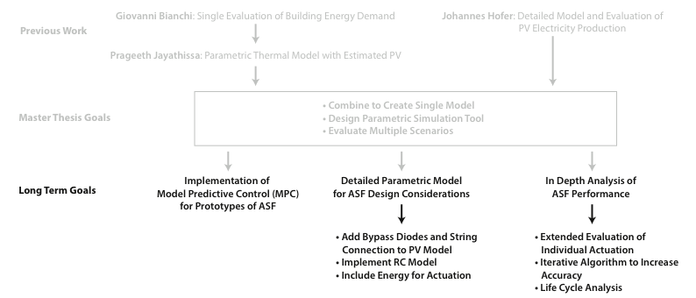
Outlook
Notes:
capitalization

Slide 25
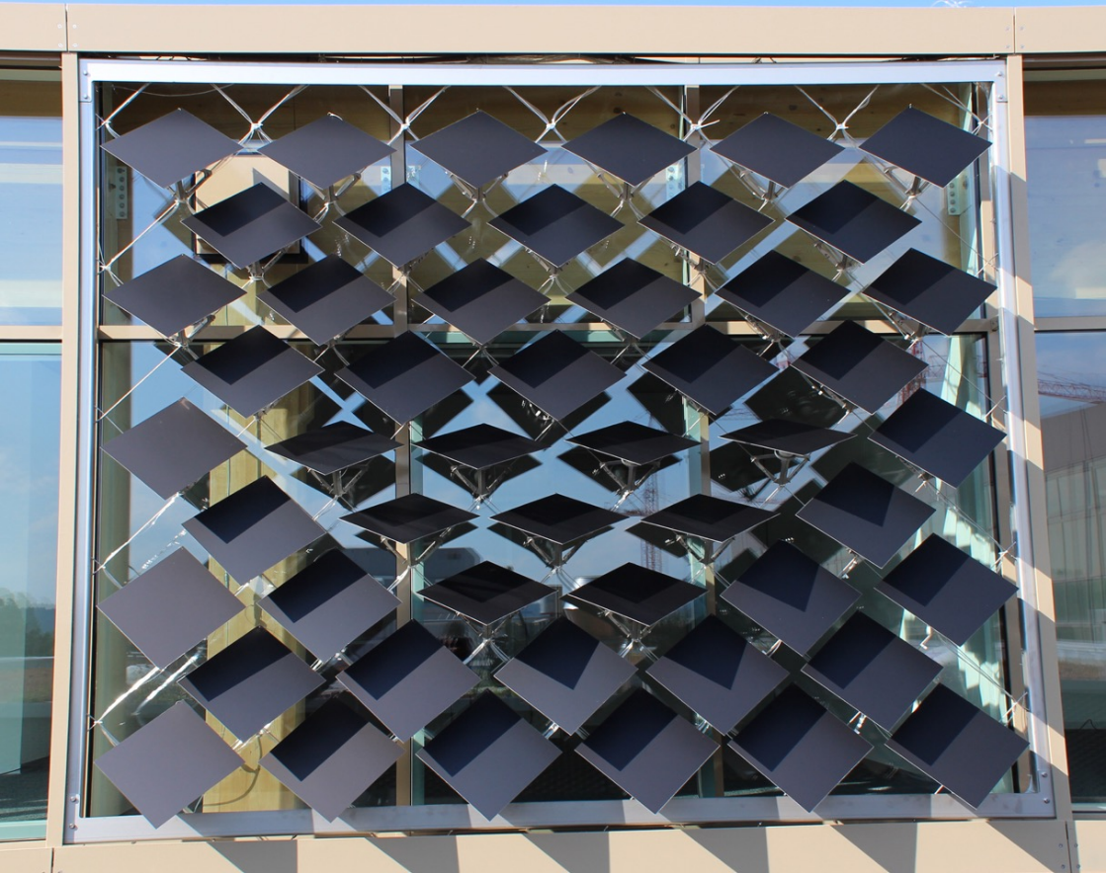
Questions?
https://github.com/architecture-building-systems/ASF_Simulation

Slide 26
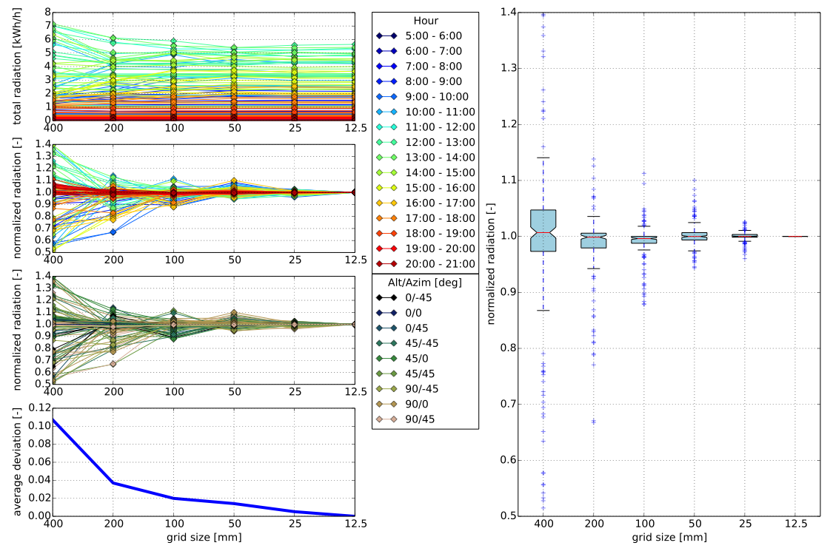
Grid Convergence Study

Slide 27
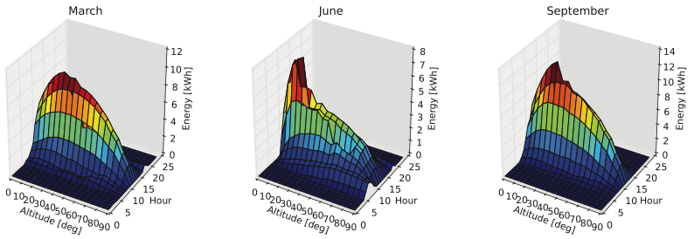
Influence of Actuation
Strongest Influence at Noon
Optimizing for Cooling and PV (closed positions)

Slide 28
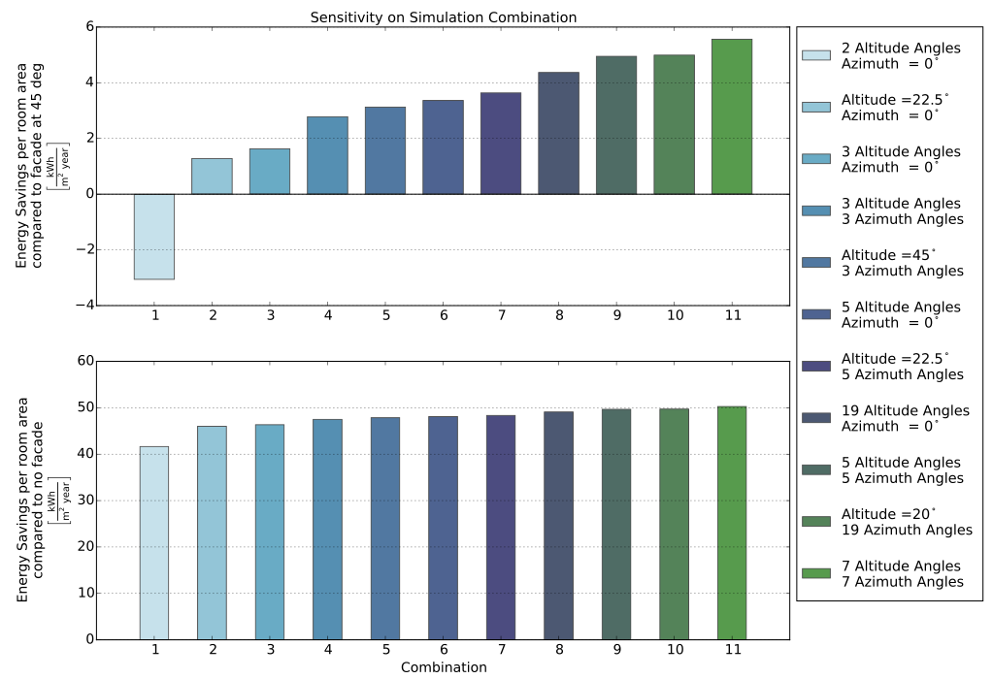
Sensitivity on Simulation Combination

Slide 29
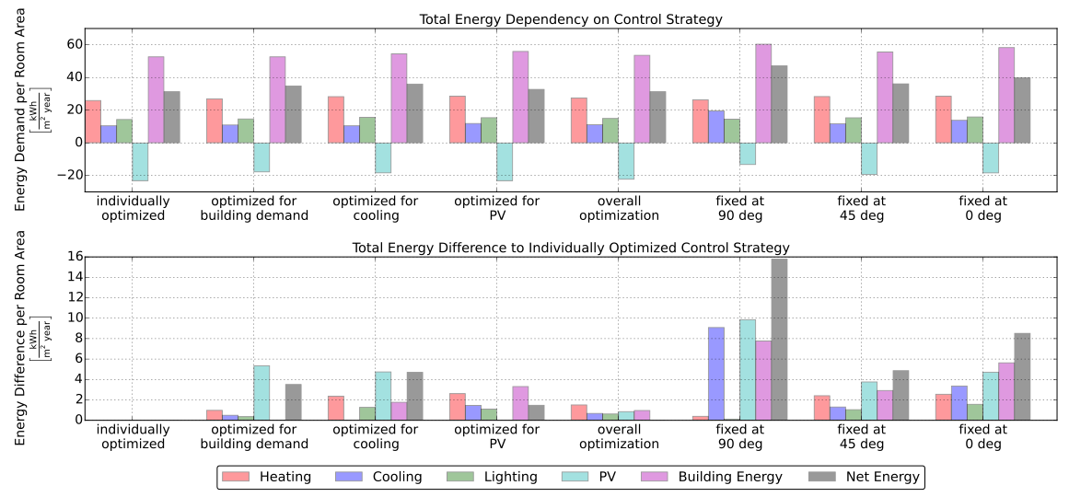
Energy Dependency on Control Strategy
Results for 7 Azimuth and 7 Altitude Angles

Slide 30
Cluster Analysis
2 Clusters
10 Panels for Radiation
5 Azimuth / 5 Altitude Angles
3 Clusters
8 Panels for Radiation
1 Azimuth / 5 Altitude Angles
June
1%
2.3%
Average of
Mar, Jun,
Sep, Dec

Slide 31
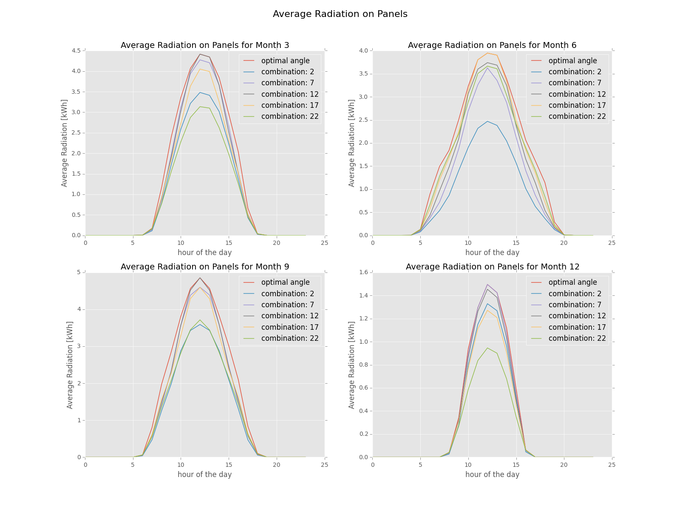
Conclusions
Developed Simulation Framework for the ASF
Optimum Angle Combinations Found
Possibility to Include PV-Electricity Production

Slide 32
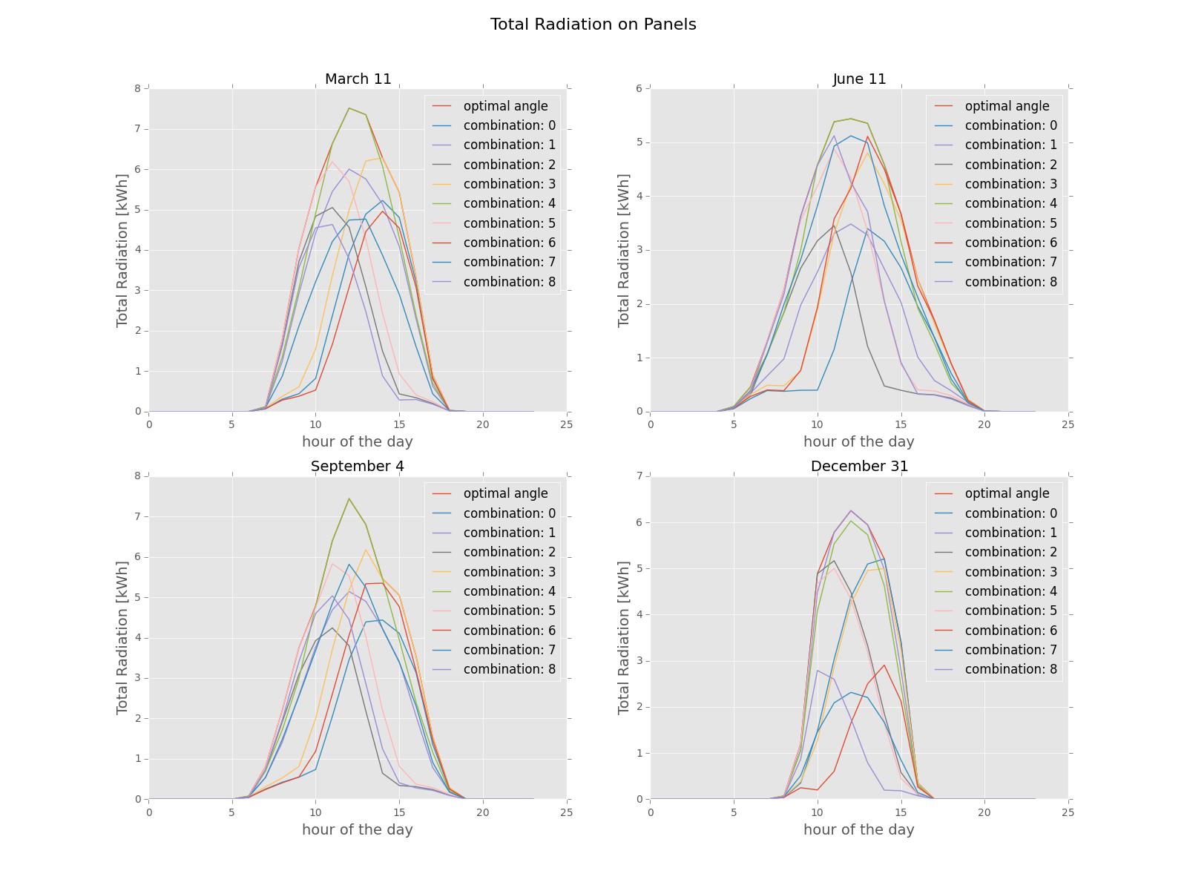
Conclusions
Developed Simulation Framework for the ASF
Optimum Angle Combinations Found
Possibility to Include PV-Electricity Production

Slide 33
Conclusions
Developed Parametric Simulation Model for PV Modules as Adaptive Building Shading Systems
Successfully combined detailed PV-Electricity Production with Building Energy Demand
Optimal Angles for single Cluster found
Sensitivity on Building Orientation, Location, System and Control Strategy evaluated

Slide 34
Outlook
Development and Implementation of RC-Building Energy Simulation Tool
Include Bypass Diodes and String Connection in PV Electricity Simulation
Include Energy-Use for Actuation in Simulation
Implement Iterative Algorithm to increase Accuracy
Extended Evaluation of individual Actuation
Development of Control System for Prototypes of ASF
Life Cycle Analysis

